Slide 1
Competitor Analysis Report
This Deck is to show the analysis from subjective and relatively objective views on McDonalds and its competitors in order to have a comprehensive understanding over McDonalds’ pros and cons in china local market so that some targeted suggestions like how to drive traffic and conversion from a data-driven view would be given to help McDonald‘s increase new customers and enhance existing customers loyalty.
By David Ding

Slide 2
Contents
PART I
Analysis & Reporting
Product
Service
Environment
Brand Image
Marketing Strategy & Market Share
PART II
Suggestions
Analytical Conclusion
Brand Strategies
Marketing Strategies
Traffic Strategies
Martech Solution

Slide 3
PART I – Analysis & Reporting

Slide 4





PART I – Analysis & Reporting
This part will show how five dimensions in brand market development perform in contrast with main competitors in china local market. And below each reports, key conclusions will be pointed out to compare each other among these smiliar catering brands.
Product
Service
Environment
Brand Image
Marketing
Score from 1- 10 and do analysis on Hamburger, Fried Chips, Chickens, Drinks and Ice-cream through Variety ,Taste ,Pricing and Cost Performance
Score from 1- 10 and do analysis on offline store service in areas of waiters’ altitude and details.
Score from 1- 10 and do analysis on offline store in areas of decoration, sanitary ,store capacity, stickiness.
Score from 1- 10 and do analysis on brand image in areas of high value sense, popularity, likeness.
Score from 1- 10 and do analysis on marketing in areas of new product strategies, hot sale strategies, coupon and discounts ,credit member maintenance

Slide 5

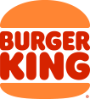
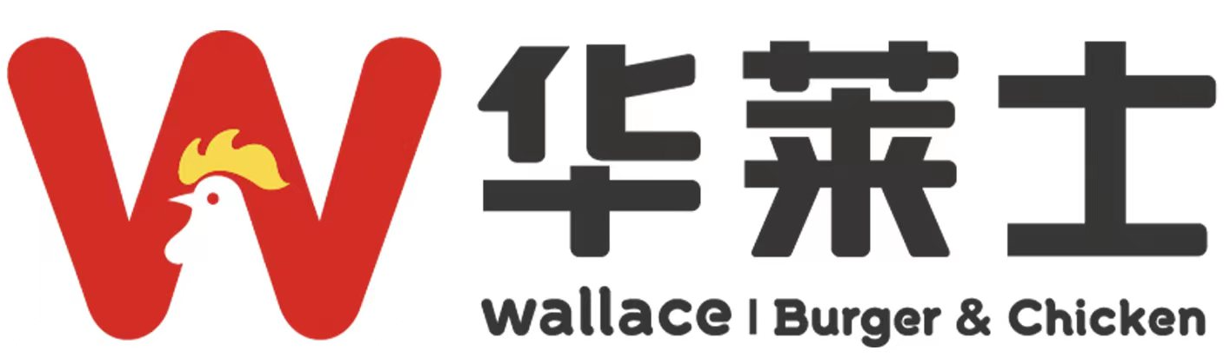

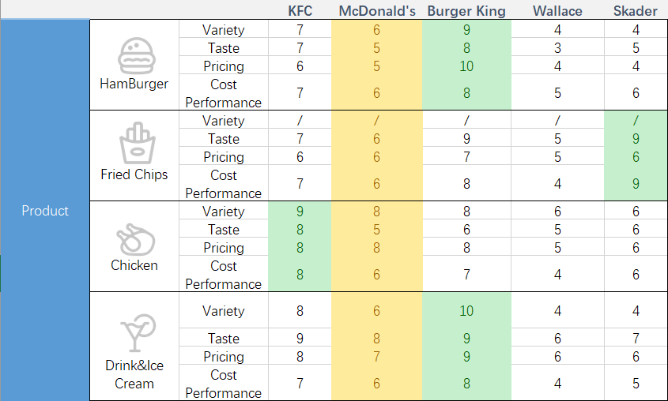
Product Scoring
Taking KFC, Burger King, Wallace, Skader as competitors, score from 1(bad\cheap) to 10(good\expensive).

Slide 6
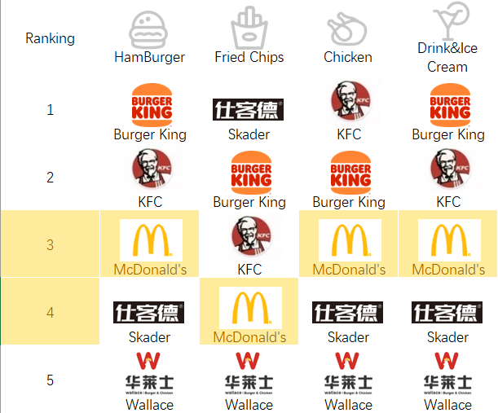
Product Ranking
As shown left, we will know:
KFC & Burger King do better comprehensively in products than McDonald’s.
KFC, Burger King and even Skader has featured and top ranking product series. McDonald’s doesn’t take the first place in any product series.
According to the score table, McDonald’s is weak in:
Burgers’ variety and taste
Chips’ taste,
Chicken taste
Drinks’ variety.

Slide 7
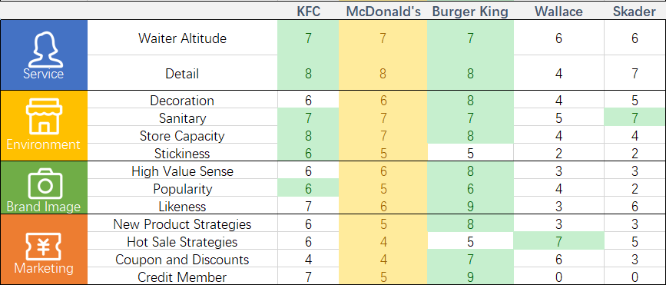
Comprehensive Scoring
Taking KFC, Burger King, Wallace, Skader as competitors, score from 1(bad) to 10(good).
As indicated above:
Comprehensively, McDonald take an above-average place in service, environment, Brand Image and Marketing.
Typically, the same as KFC, Burger King, McDonald’s is weak in customer stickiness.
Just for McDonald’s, products that show high value of brands and enhance popularity and likeness need developing. Meanwhile, these successfully tested new products could relatively set as a high price product to enhance the high value sense of the brand.
Another, hot sales strategies are the key point of driving stable cash flow and rich revenue. And on the base of high value sense, coupons & discounts, and Credit Member Strategies could better lock the customers and maintain the loyalty.

Slide 8
PART II – Suggestions

Slide 9

Analytical Conclusion
This part will have a conclusion on disadvantages of McDonald’s that has been presented at Part I, in order to have a highlight on these points and accordingly make some optimization suggestions on next slides.
Lack of new product attractiveness and combinations with Chinese local feature food.
Lack of good chip shape and crispy on the outside and tender on the inside.
Lack of high price and highly enjoying food(high cost performance).
Lack of burgers’ and drinks’ variety and chicken taste and innovation.
Product
Service
Lack of energetic and affinitive waiter service
Weakness
Env.
Lack of fancy room design, scence design like StarBucks and easiness to lose stickiness and low brand’ high value sense.
Brand
Image
Lack of McDonald’s Core Culture highlight and advertising
Lack of high value products and market placing
Lack of high likeness products
Lack of brand engagement in product, culture, vision and etc..
Marketing
Lack of Market Strategies difference on different area
Lack of mid-term and long-time brand marketing think.
Lack of a highly-cycling and consecutive developing layout on organic digital marketing and AI-driven boost sales

Slide 10
Brand Strategies (Long Term)
A successfully brand strategy should be a long term without sacrifice on brand image in product, service, environment, and even brand idea and at the same time promote sales and scales to a larger level in a stable way, and even endure the risk in lower economy expectation environment.
Brand Lifting
Service Lifting
Overcome the Future
Close to Society News and Trends, do some charity activities to lift brand image, especially in child pre education, nature disaster aid, child care and etc.
Optimize Membership service.
Optimize Offline service in areas of wait’s altitude, auto order system, store sanitation, take away service.
Optimize online mini program, apps on simplified interactions, explicit functions, easy payment, reduce duplicated and redundant functions and apps
Product Lifting
Product is very important in maintaining brand image through its price, taste, innovation, certain and outstand features.
Gradually, lift product on mentions items in a short term and maintain it with high exposure and sale strategies
Develop more type of snacks to lock on those YUPs in the afternoon and evening.
Environment Lifting
New Design Pattern according to new name ”金拱门
Friendly-to-YUP decoration design, layout design and physical interaction facilities

Slide 11
Marketing Strategies (Short Term)
1. New Product Strategies
Pricing Strategies
2. Hot Sales Strategies
15%-20% new featured product with a new-push cycle.
High Price Maintenance on new product.
Push new product mainly to returning and loyal customers over than new customer.
A little bit high price on hot sales.
Push hot sales to new customers with relatively high discounts and more coupons
Result out featured product combinations to pushing sales on featured customers
Hot sales single product not set into combinations
2
1
Area Diff Type: CBD District/Residential area in Top Cities/Transportation hub/Small and Middle City
CBD focus on new and high-price products and featured product,
Residential area focus on hot sales and 20% new an high-price products and push full in membership system promotion,
Transportation hub and above 4A Tour Points focus on hot sales combinations and set higher price on these combinations.
Import and integrate area local feature product and possibly push the most popular innovation to all the areas.
4
3
Maintain high price strategies
Let out member’s day not to a settled work day
Set credit exchange to those hot sale snacks or certain cold sale burger.
Periodically clean out credit
Union with other industry top brand to raise some campaign's and activites
Push large amount deposit with coupons or discounts
4. Area Strategies
3. Membership Credit Strategies

Slide 12
Traffic Strategies
Traffic Common Principle
None-Tag large Scale Traffic
High Input,
Low Return
Long Term Efficiency
/Brand Strength
Stable ROI
(1.2-1.8)
Small Stream Featured Traffic
Low Input,
High Return
Short Term Conversion/ROI/Sales

Slide 13
Traffic Strategies
Platform Principle
 | Focus | Feature | Target | Traffic Paid Percentage
Tiktok | Coupon & Discount Exposure Brand Union Campaign Traffic Tag Analysis & Precise Segment & Precise Science Interaction Membership Credit | Fast Exposure Precise Target Large Scale Nice Conversion Offline Store Lift Up | Mini Program "麦乐送“ Doudian Coupons | 50%-70%
WeChat | Offline Store Conversion Private Traffic Operation | Maintain Fans to mini program Convert Buyers to loyal members | Mini Program "麦当劳“, especially member center | 20%-40%
Xiaohongshu | New Products Promotion New Campaigns Promotion Series Product Leads Teach user about McDonald food culture | Get New Leads Teach More Knowledge Prepare and Enhance Future Brand Image | WeChat Mini Program "麦当劳” Offline Store | 30%-50%
Screen Ads in top apps | Themed Brand Themed Campaign Themed Products Themed Combinations | Get New Leads Increase Brand Image Exposure | WeChat Mini Program "麦当劳” | 20%-40%
Offline Alipay Red Pack | Red Pack Discount Conversion | Discounts | Alipay Mini Program "麦当劳” | 10-30%
Other Media | Hot Sales Product Discount | Normal Traffic Normal Exposure | WeChat Mini Program "麦当劳” | 10-30%

Slide 14









Martech Solution
These Martech Solution is a primary level solution and simply shows that a simple way that brand owner could use 1st party, 2nd party and 3rd party data do business and enhance data efficiency and growing business value.
Data Clue
Data Hub
Data Application
Data Target
Data Consuming Flow
Live
Tictok DouDian
Data Collecting Flow
McDonald’s
Data Lake
Content Ads
Wechat Mini Program
Offline Store
Coupons
AliPay Mini Program

Slide 15
THANK YOU FOR ATTENTION

